Slide 1
Electronic circuit analysis minor project
181FA05093
181FA05161
181FA05176

Slide 2
Aim:- To design a very simple cell phone detector circuit and analyse the circuit.
Apparatus:-
CA3130 IC
BC548 Transistor
2.2M Ω Resistor (x2)
100K Ω Resistor
1K Ω Resistor
100μF Capacitor (50V)
0.22μF Capacitor
47pF Capacitor
LED (Light Emitting Diode)
9V Battery
9V Battery Clip
Breadboard

Slide 3
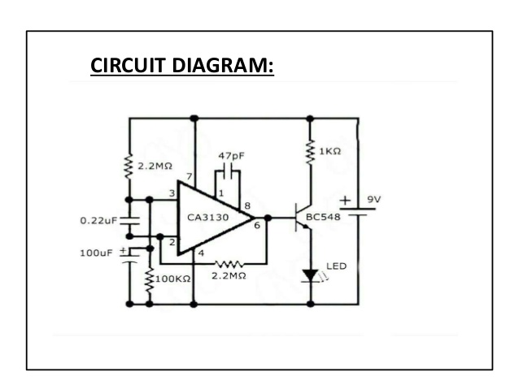
Circuit diagram

Slide 4
Theory:-
Cell phone detector is a circuit that sense the presence of any activated cell phone nearby and gives an indication of activated cell phone near around of it. It is a frequency detector which catches frequencies about 0.8-3GHz.This is very helpful to detect cell phones at cell phones restricted places like exam cells, meeting rooms, hospitals etc.
It can detect both the incoming and outgoing calls, SMS and video transmission even if the cell phone is kept in silent mode. The moment the bug detects RF transmission signal from an activated cell phone, the LED starts blinking, until signal transmission ceases.

Slide 5
Working:-
Ordinary LC (Coil-Capacitor) circuits are used to detect low frequency radiation in the AM and FM bands . It can detect maximum MHz frequency. From Mobile phone we get frequency in terms of GHz.
The transmission frequency of mobile phone ranges from 0.9 to 3 GHz with wave length of 3.3 to 10 cm .so a circuit detecting GHz signals is required.
Here 0.22 µF disk capacitor is used to capture the RF signals from the mobile phone. This along with the leads act as a small GHz loop antenna to collect the RF signals.

Slide 6
One lead of the capacitor gets DC from the positive rail and the other lead goes to the negative input of IC.
The capacitor gets energy for storage. This energy is applied to the input of the IC . So the inputs of IC is almost balanced and output is almost zero. But at any time IC can give a high output if a small current is induced to its inputs.
There is a natural electromagnetic field around the capacitor caused by the 50Hz from electrical wiring. When the mobile phone radiates high frequency radiation, capacitor oscillates and release energy in the inputs of IC. This oscillation is indicated by the flashing of the LED.

Slide 7
In short, capacitor carries energy and is in an electromagnetic field. So a slight change in field caused by the RF signals from phone will disturb the field and forces the capacitor to release energy.
The LED blinks until the signal ceases.

Slide 8
ADVANTAGES:-
The circuit is small in size.
It can be used for detecting cell phones used for spying and transmission of unauthorized audios and videos.
DISADVANTAGES:-
It is a short range detector, of the order of centimetres.
The presence of this device would jam the signals of other devices due to the fluctuations.

Slide 9
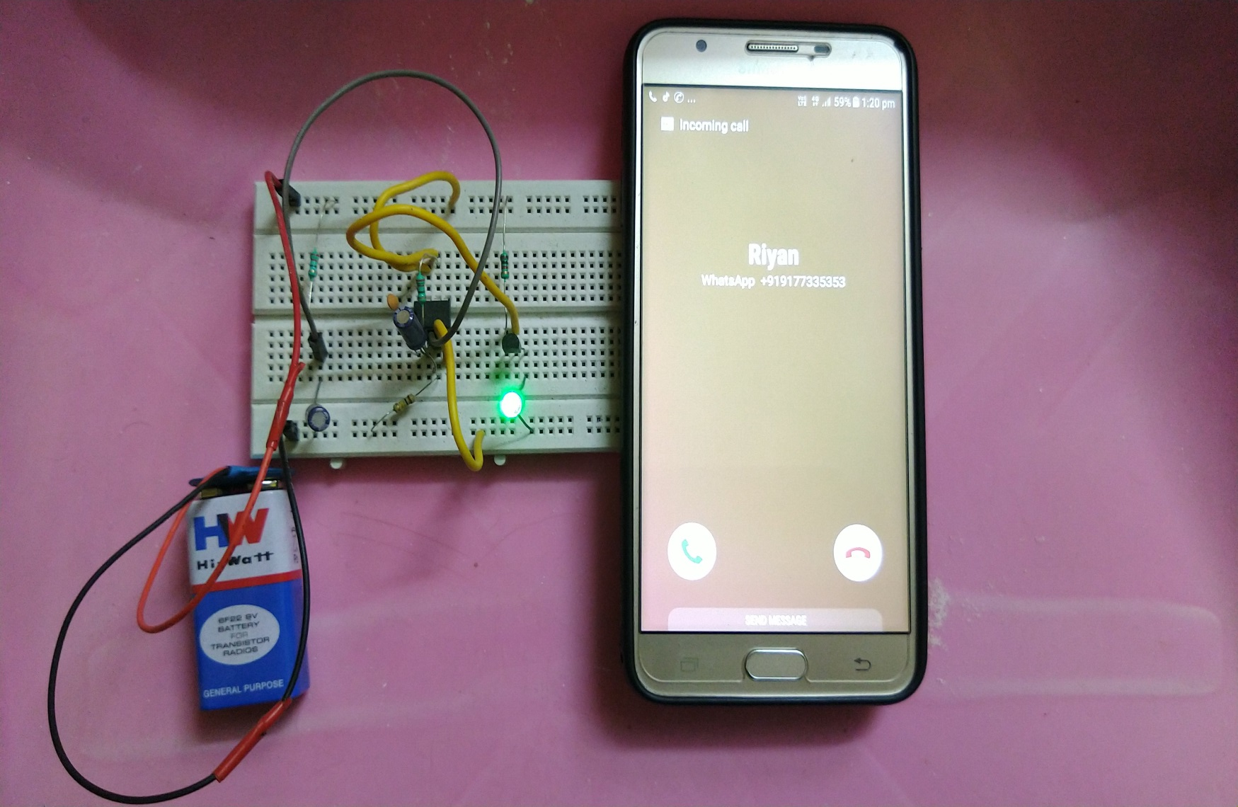

Slide 10
Applications:-
This circuit can be used to detect the presence of active cell phones at examination halls and meetings.
It can be used to detect active cell phones in Hospitals, Petrol pumps, Court of law and Military bases.

